Slide 1

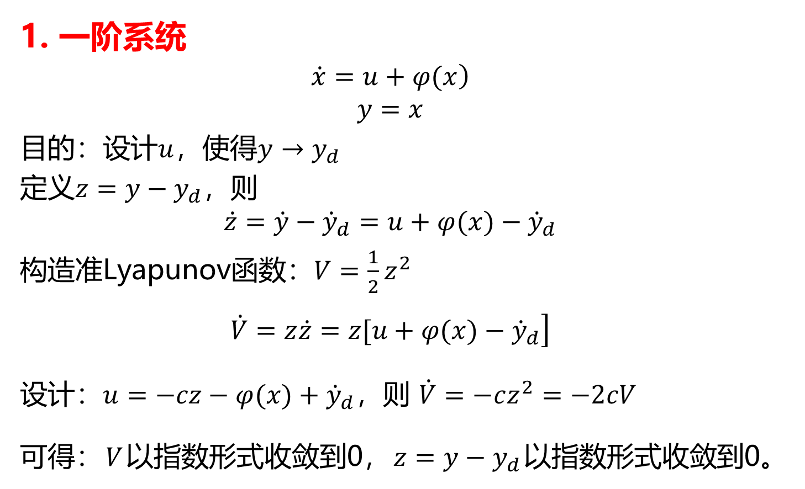
1. 一阶系统
$$\left.\dot{x}=u+φ(x\right)$$
$$y=x$$
目的：设计$u$，使得$y→y_{d}$
定义$z=y−y_{d}$，则
$$\dot{z}=\dot{y}−{\dot{y}}_{d}=u+φ(x)−{\dot{y}}_{d}$$
构造准Lyapunov函数：$V=\frac{1}{2}z^{2}$
$$\begin{matrix} \\ \left.\dot{V}=z\dot{z}=z[u+φ(x)−{\dot{y}}_{d}\right]\end{matrix}$$
设计：$u=−cz−φ(x)+{\dot{y}}_{d}$，则 $\dot{V}=−cz^{2}=−2cV$
可得：$V$以指数形式收敛到0，$z=y−y_{d}$以指数形式收敛到0。

Slide 2

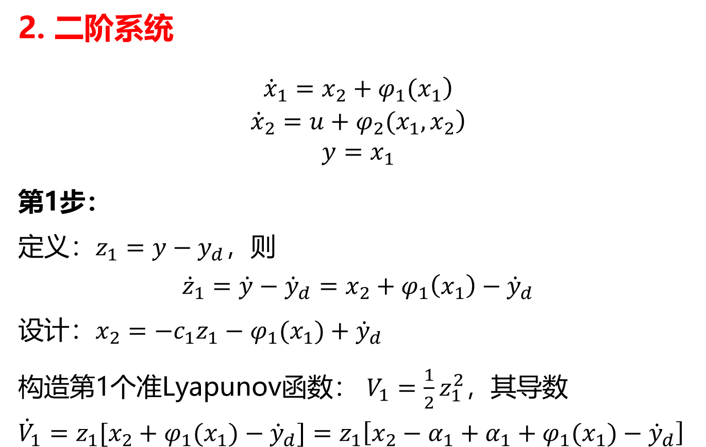
2. 二阶系统
$$\begin{matrix}\left.{\dot{x}}_{1}=x_{2}+φ_{1}(x_{1}\right) \\ \begin{aligned}\left.{\dot{x}}_{2}=u+φ_{2}(x_{1},x_{2}\right) \\ y=x_{1}\end{aligned} \\ \end{matrix}$$
第1步：
定义$：z_{1}=y−y_{d}，则$
$${\dot{z}}_{1}=\dot{y}−{\dot{y}}_{d}=x_{2}+φ_{1}\left(x_{1}\right)−{\dot{y}}_{d}$$
设计：$x_{2}=−c_{1}z_{1}−φ_{1}(x_{1})+{\dot{y}}_{d}$
构造第1个准Lyapunov函数： $V_{1}=\frac{1}{2}z_{1}^{2}$，其导数
$${\dot{V}}_{1}=z_{1}[x_{2}+φ_{1}(x_{1})−{\dot{y}}_{d}]=z_{1}\left[x_{2}−α_{1}+α_{1}+φ_{1}(x_{1})−{\dot{y}}_{d}\right]$$

Slide 3
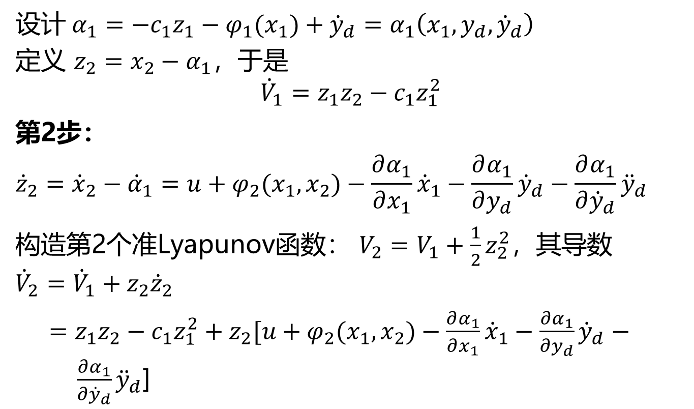
设计$α_{1}=−c_{1}z_{1}−φ_{1}(x_{1})+{\dot{y}}_{d}=α_{1}\left(x_{1},y_{d},{\dot{y}}_{d}\right)$
定义 $z_{2}=x_{2}−α_{1}$，于是
$${\dot{V}}_{1}=z_{1}z_{2}−c_{1}z_{1}^{2}$$
第2步：
$${\dot{z}}_{2}={\dot{x}}_{2}−{\dot{α}}_{1}=u+φ_{2}(x_{1},x_{2})−\frac{∂α_{1}}{∂x_{1}}{\dot{x}}_{1}−\frac{∂α_{1}}{∂y_{d}}{\dot{y}}_{d}−\frac{∂α_{1}}{∂{\dot{y}}_{d}}{\ddot{y}}_{d}$$
构造第2个准Lyapunov函数： $V_{2}=V_{1}+\frac{1}{2}z_{2}^{2}$，其导数
$${\dot{V}}_{2}={\dot{V}}_{1}+z_{2}{\dot{z}}_{2}$$
$=z_{1}z_{2}−c_{1}z_{1}^{2}+z_{2}[u+φ_{2}(x_{1},x_{2})−\frac{∂α_{1}}{∂x_{1}}{\dot{x}}_{1}−\frac{∂α_{1}}{∂y_{d}}{\dot{y}}_{d}− \frac{∂α_{1}}{∂{\dot{y}}_{d}}{\ddot{y}}_{d}$]

Slide 4
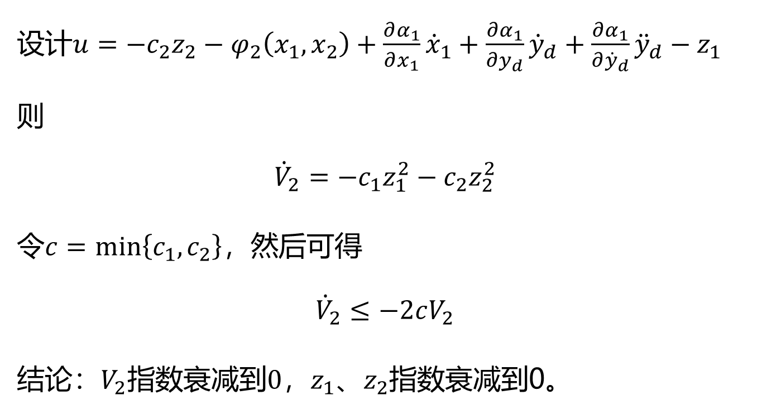
设计$u=−c_{2}z_{2}−φ_{2}\left(x_{1},x_{2}\right)+\frac{∂α_{1}}{∂x_{1}}{\dot{x}}_{1}+\frac{∂α_{1}}{∂y_{d}}{\dot{y}}_{d}+\frac{∂α_{1}}{∂{\dot{y}}_{d}}{\ddot{y}}_{d}−z_{1}$
则
$${\dot{V}}_{2}=−c_{1}z_{1}^{2}−c_{2}z_{2}^{2}$$
令$c=min\left\{c_{1},c_{2}\right\}$，然后可得
$${\dot{V}}_{2}≤−2cV_{2}$$
结论：$V_{2}$指数衰减到$0$，$z_{1}、z_{2}$指数衰减到0。

Slide 5
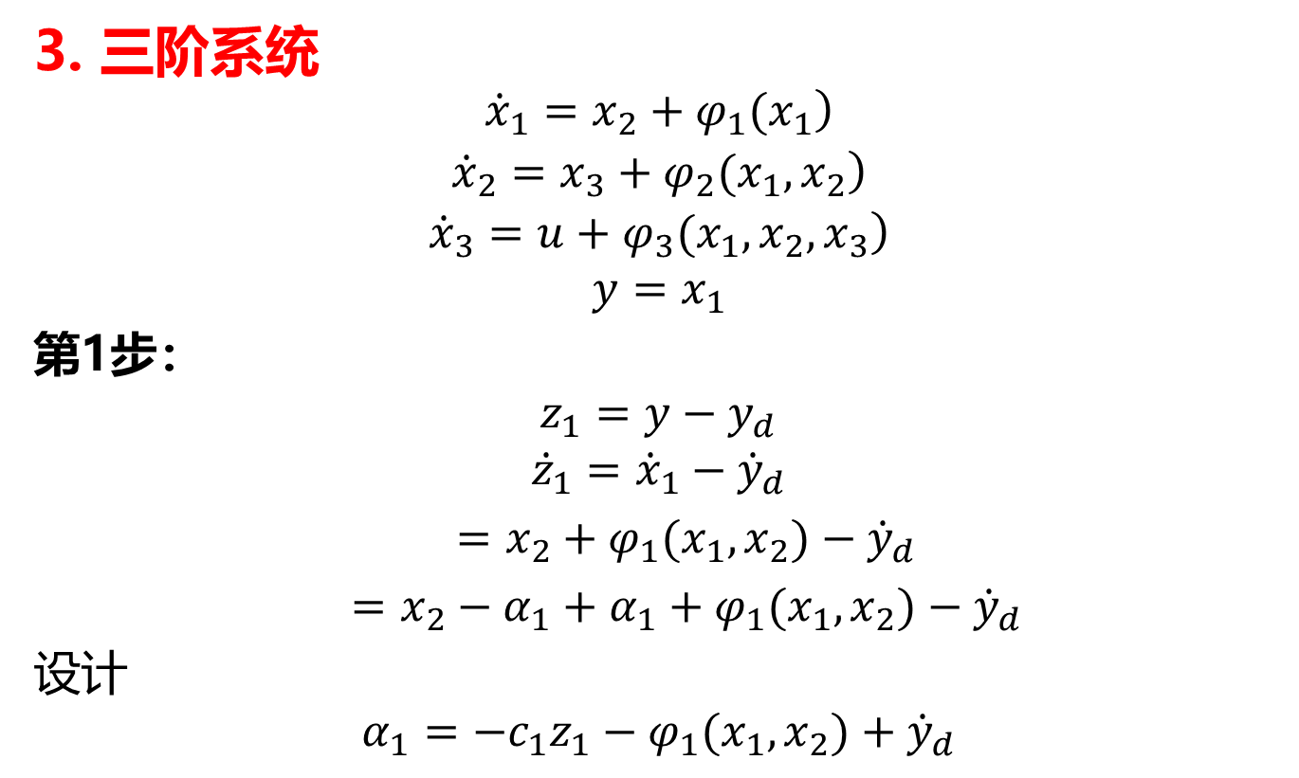
3. 三阶系统
$$\begin{matrix}\left.{\dot{x}}_{1}=x_{2}+φ_{1}(x_{1}\right) \\ \left.{\dot{x}}_{2}=x_{3}+φ_{2}(x_{1},x_{2}\right) \\ \begin{aligned}\left.{\dot{x}}_{3}=u+φ_{3}(x_{1},x_{2},x_{3}\right) \\ y=x_{1}\end{aligned}\end{matrix}$$
第1步：
$$z_{1}=y−y_{d}$$
$${\dot{z}}_{1}={\dot{x}}_{1}−{\dot{y}}_{d}$$
$=x_{2}+φ_{1}(x_{1},x_{2})−{\dot{y}}_{d}$
$=x_{2}−α_{1}+α_{1}+φ_{1}(x_{1},x_{2})−{\dot{y}}_{d}$
设计
$$α_{1}=−c_{1}z_{1}−φ_{1}(x_{1},x_{2})+{\dot{y}}_{d}$$

Slide 6

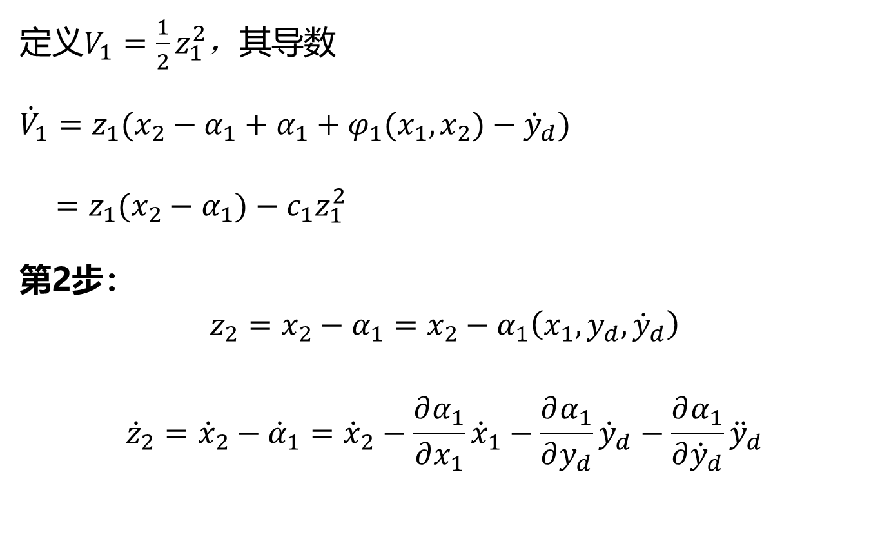
定义$V_{1}=\frac{1}{2}z_{1}^{2}$，其导数
$${\dot{V}}_{1}=z_{1}(x_{2}−α_{1}+α_{1}+φ_{1}(x_{1},x_{2})−{\dot{y}}_{d})$$
$=z_{1}(x_{2}−α_{1})−c_{1}z_{1}^{2}$
第2步：
$$z_{2}=x_{2}−α_{1}=x_{2}−α_{1}\left(x_{1},y_{d},{\dot{y}}_{d}\right)$$
$${\dot{z}}_{2}={\dot{x}}_{2}−{\dot{α}}_{1}={\dot{x}}_{2}−\frac{∂α_{1}}{∂x_{1}}{\dot{x}}_{1}−\frac{∂α_{1}}{∂y_{d}}{\dot{y}}_{d}−\frac{∂α_{1}}{∂{\dot{y}}_{d}}{\ddot{y}}_{d}$$

Slide 7
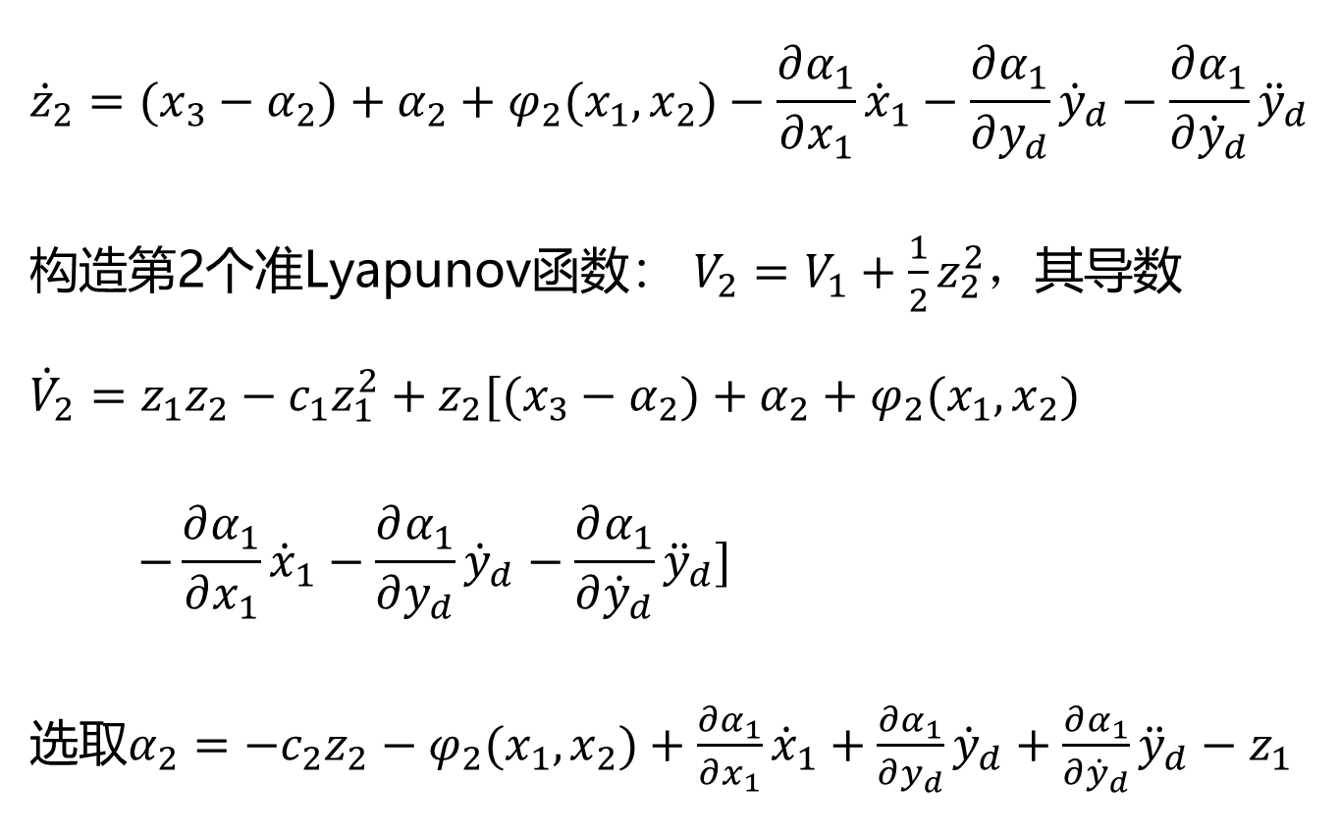
$${\dot{z}}_{2}=(x_{3}−α_{2})+α_{2}+φ_{2}(x_{1},x_{2})−\frac{∂α_{1}}{∂x_{1}}{\dot{x}}_{1}−\frac{∂α_{1}}{∂y_{d}}{\dot{y}}_{d}−\frac{∂α_{1}}{∂{\dot{y}}_{d}}{\ddot{y}}_{d}$$
构造第2个准Lyapunov函数： $V_{2}=V_{1}+\frac{1}{2}z_{2}^{2}$，其导数
$${\dot{V}}_{2}=z_{1}z_{2}−c_{1}z_{1}^{2}+z_{2}[(x_{3}−α_{2})+α_{2}+φ_{2}(x_{1},x_{2})$$
$$−\frac{∂α_{1}}{∂x_{1}}{\dot{x}}_{1}−\frac{∂α_{1}}{∂y_{d}}{\dot{y}}_{d}−\frac{∂α_{1}}{∂{\dot{y}}_{d}}{\ddot{y}}_{d}]$$
选取$α_{2}=−c_{2}z_{2}−φ_{2}(x_{1},x_{2})+\frac{∂α_{1}}{∂x_{1}}{\dot{x}}_{1}+\frac{∂α_{1}}{∂y_{d}}{\dot{y}}_{d}+\frac{∂α_{1}}{∂{\dot{y}}_{d}}{\ddot{y}}_{d}−z_{1}$

Slide 8
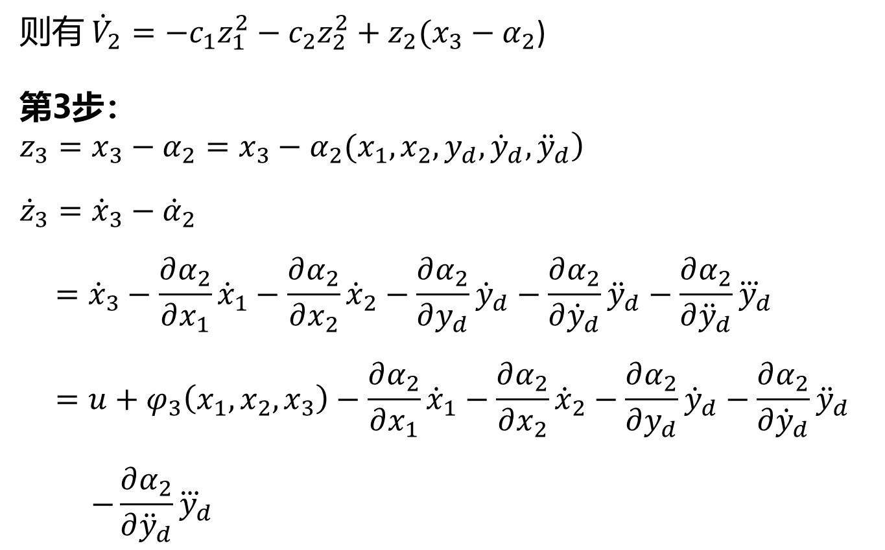
则有 ${\dot{V}}_{2}=−c_{1}z_{1}^{2}−c_{2}z_{2}^{2}+z_{2}(x_{3}−α_{2}$)
第3步：
$$\left.z_{3}=x_{3}−α_{2}=x_{3}−α_{2}(x_{1},x_{2},y_{d},{\dot{y}}_{d},{\ddot{y}}_{d}\right)$$
$${\dot{z}}_{3}={\dot{x}}_{3}−{\dot{α}}_{2}$$
$$={\dot{x}}_{3}−\frac{∂α_{2}}{∂x_{1}}{\dot{x}}_{1}−\frac{∂α_{2}}{∂x_{2}}{\dot{x}}_{2}−\frac{∂α_{2}}{∂y_{d}}{\dot{y}}_{d}−\frac{∂α_{2}}{∂{\dot{y}}_{d}}{\ddot{y}}_{d}−\frac{∂α_{2}}{∂{\ddot{y}}_{d}}{\overset{⃛}{y}}_{d}$$
$$=u+φ_{3}\left(x_{1},x_{2},x_{3}\right)−\frac{∂α_{2}}{∂x_{1}}{\dot{x}}_{1}−\frac{∂α_{2}}{∂x_{2}}{\dot{x}}_{2}−\frac{∂α_{2}}{∂y_{d}}{\dot{y}}_{d}−\frac{∂α_{2}}{∂{\dot{y}}_{d}}{\ddot{y}}_{d}$$
$$−\frac{∂α_{2}}{∂{\ddot{y}}_{d}}{\overset{⃛}{y}}_{d}$$

Slide 9
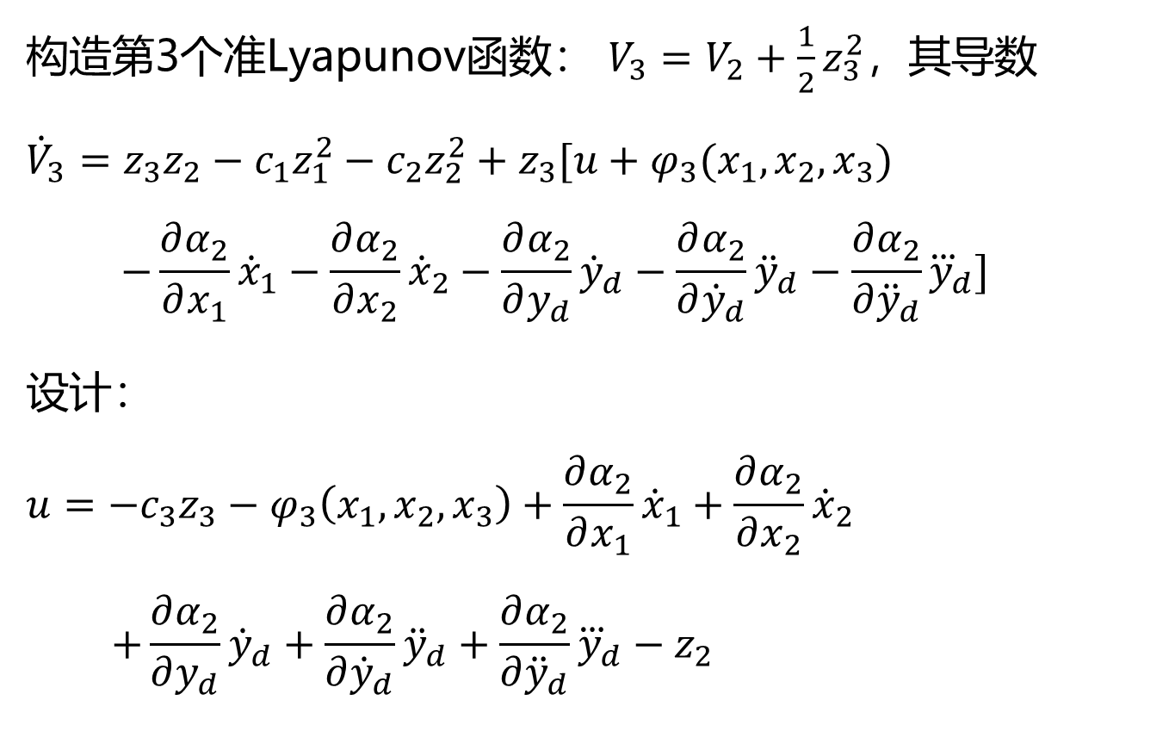
构造第3个准Lyapunov函数： $V_{3}=V_{2}+\frac{1}{2}z_{3}^{2}$，其导数
$${\dot{V}}_{3}=z_{3}z_{2}−c_{1}z_{1}^{2}−c_{2}z_{2}^{2}+z_{3}[u+φ_{3}(x_{1},x_{2},x_{3})$$
$$−\frac{∂α_{2}}{∂x_{1}}{\dot{x}}_{1}−\frac{∂α_{2}}{∂x_{2}}{\dot{x}}_{2}−\frac{∂α_{2}}{∂y_{d}}{\dot{y}}_{d}−\frac{∂α_{2}}{∂{\dot{y}}_{d}}{\ddot{y}}_{d}−\frac{∂α_{2}}{∂{\ddot{y}}_{d}}{\overset{⃛}{y}}_{d}]$$
设计：
$$u=−c_{3}z_{3}−φ_{3}\left(x_{1},x_{2},x_{3}\right)+\frac{∂α_{2}}{∂x_{1}}{\dot{x}}_{1}+\frac{∂α_{2}}{∂x_{2}}{\dot{x}}_{2}$$
$$+\frac{∂α_{2}}{∂y_{d}}{\dot{y}}_{d}+\frac{∂α_{2}}{∂{\dot{y}}_{d}}{\ddot{y}}_{d}+\frac{∂α_{2}}{∂{\ddot{y}}_{d}}{\overset{⃛}{y}}_{d}−z_{2}$$

Slide 10

则：${\dot{V}}_{3}=−c_{1}z_{1}^{2}−c_{2}z_{2}^{2}−c_{3}z_{3}^{2}$
取$c=min\left\{c_{1},c_{2},c_{3}\right\}$
则： ${\dot{V}}_{3}≤−2cV_{3}$
结论： $V_{3}$指数衰减到0，$z_{1}、z_{2}、z_{3}$指数衰减到0。

